Slide 1




MARKETING
CAMPAIGNS
Analyzing campaign performance and customer insights to drive smarter marketing decisions.
01

Slide 2








MEET OUR TEAM
Shady Kamhy
Yasser Mohamed
Yumna Gamal
Lobna Salah
Ibrahim Rafaat
Ahmer Anwar
02

Slide 3

01
Introduction
02
Business Problem Statement
03
Objectives
04
Tools & Technologies
05
Agile Methodology
06
Database Schema & Integration
07
Data Warehouse Schema & Integration
08
Analysis & Reporting
AGENDA
09
Dashboard Overview
10
Recommendations
03

Slide 4
01
INTRODUCTION
04

Slide 5

INTRODUCTION
This project provides a Business Intelligence solution for DigiHype, a digital marketing company managing campaigns for clients like Apple, Samsung, Sony, Lenovo, Dell, and Huawei.
As BI developers, we analyzed customer, product, and campaign data over a defined period to measure performance, track KPIs, and deliver insights through an interactive dashboard.
05

Slide 6
02
BUSINESS
PROBLEM STATEMENT
06

Slide 7

BUSINESS PROBLEM STATEMENT
As the BI team at DigiHype, we analyzed June and July 2024, key months for product launches, summer promotions, and back-to-school campaigns for clients like Apple, Samsung, Sony, Lenovo, Dell, and Huawei. DigiHype faced challenges with fragmented data and no centralized reporting, so we focused on these high-activity months to enable short-term analysis and year-over-year performance comparison.
07

Slide 8
03
OBJECTIVES
08

Slide 9

OBJECTIVES
Analyze customer and campaign performance in June and July 2024 compared to the same months in 2025.
Identify key trends and insights on new vs. returning users, product sales, and campaign effectiveness.
01
02
Provide interactive dashboards for decision-makers to monitor performance in real time.
Deliver actionable recommendations to improve targeting, customer engagement, and ROI in future campaigns.
03
04
05
09

Slide 10
04
TOOLS
&TECHNOLOGIES
10

Slide 11












TOOLS & TECHNOLOGIES
11

Slide 12
05
AGILE
METHODOLOGY
12

Slide 13
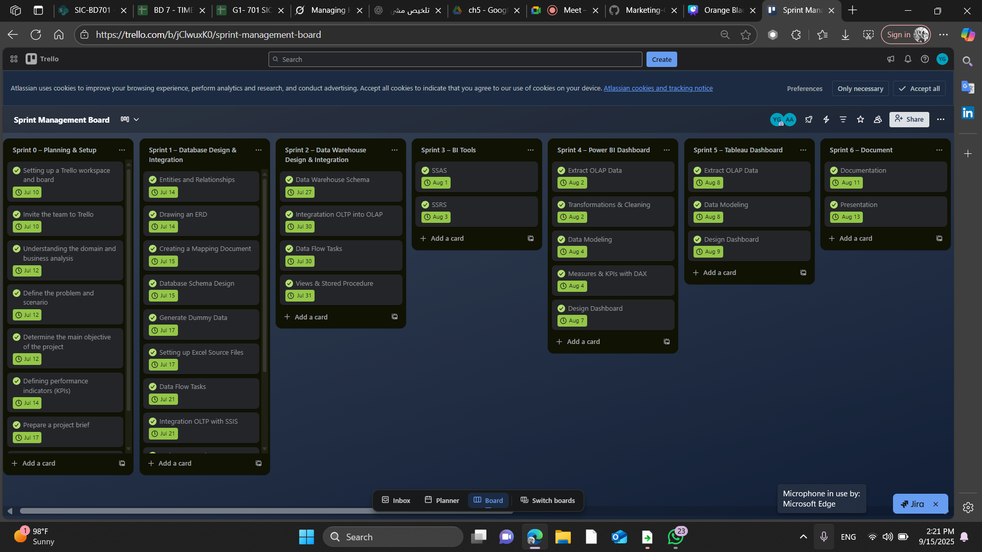
AGILE METHODOLOGY
13

Slide 14
06
DATABASE SCHEMA
& INTEGRATION
14

Slide 15
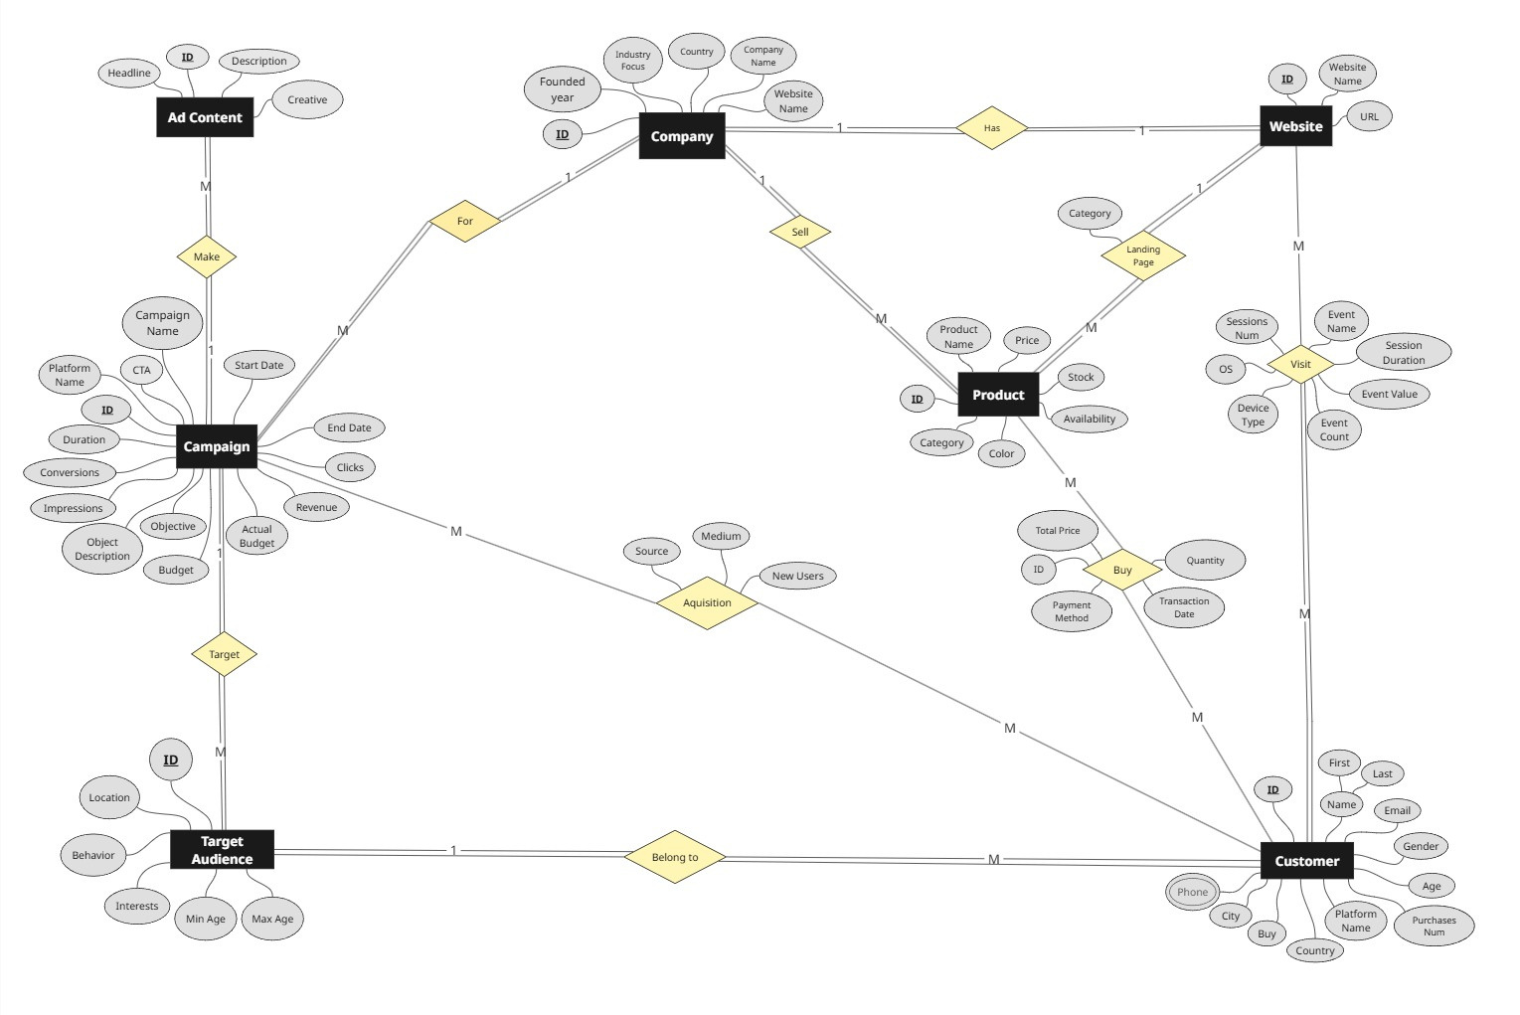
ERD
15

Slide 16
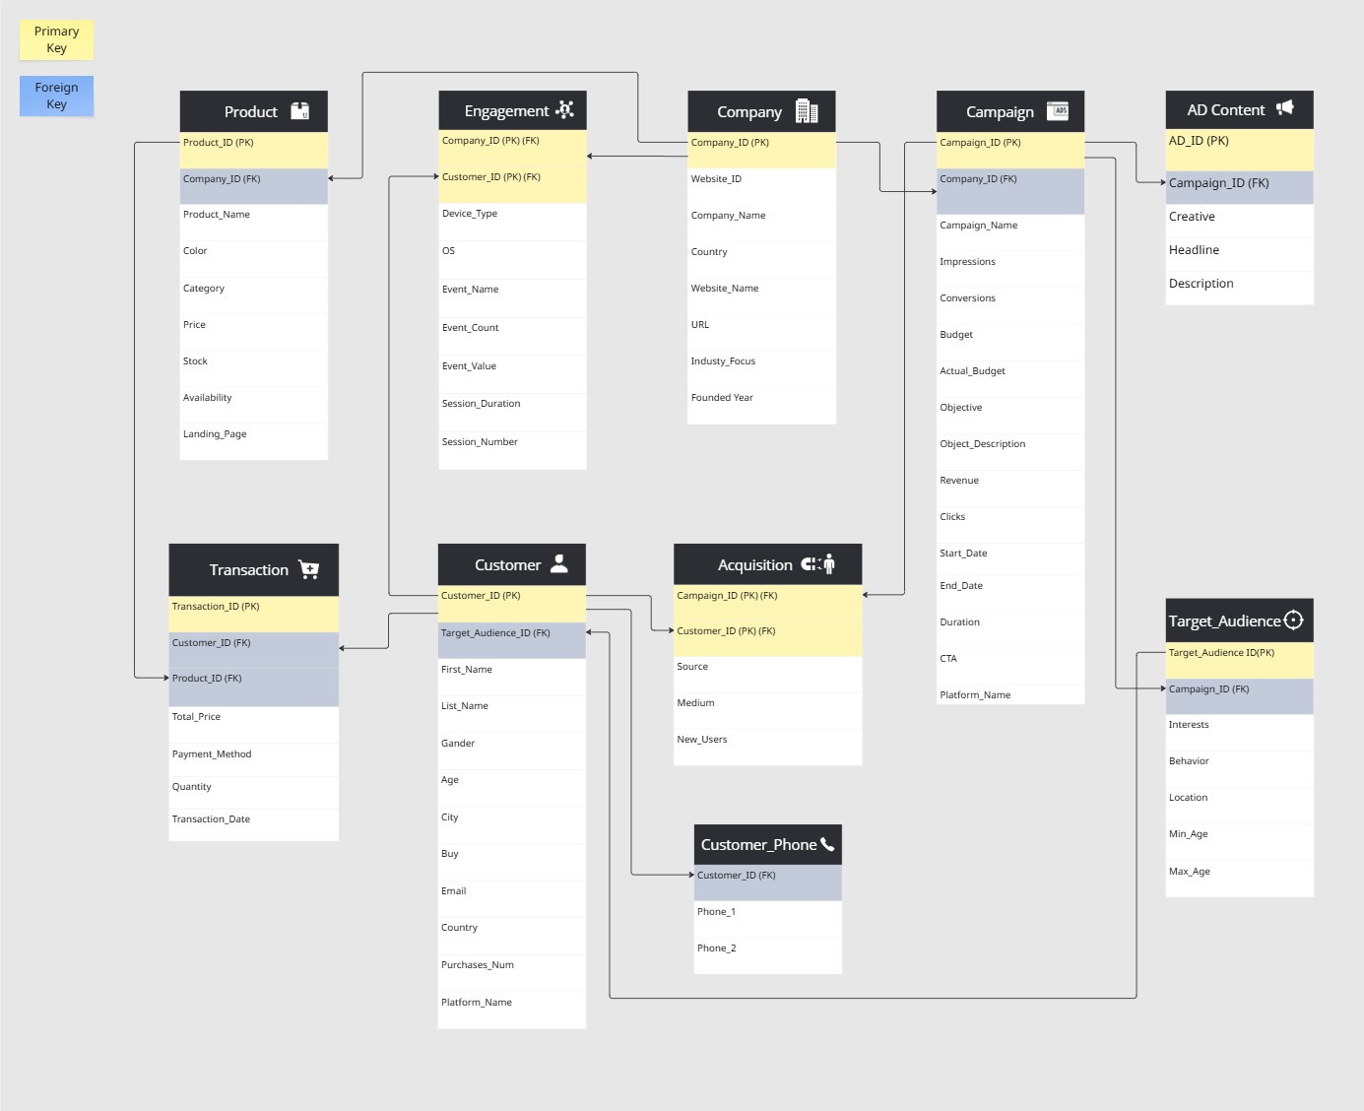
DATABASE SCHEMA
16

Slide 17
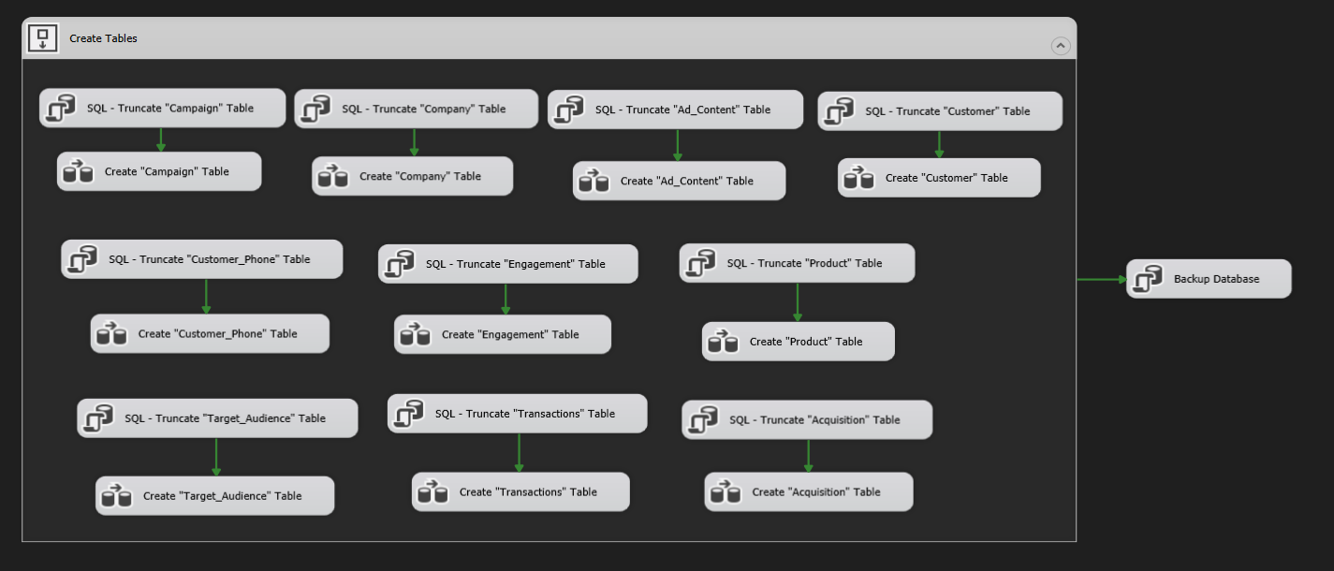
OLTP ETL - CONTROL FLOW
17

Slide 18
07
DATA WAREHOUSE
SCHEMA & INTEGRATION
Data Warehouse Schema & Integration
18

Slide 19
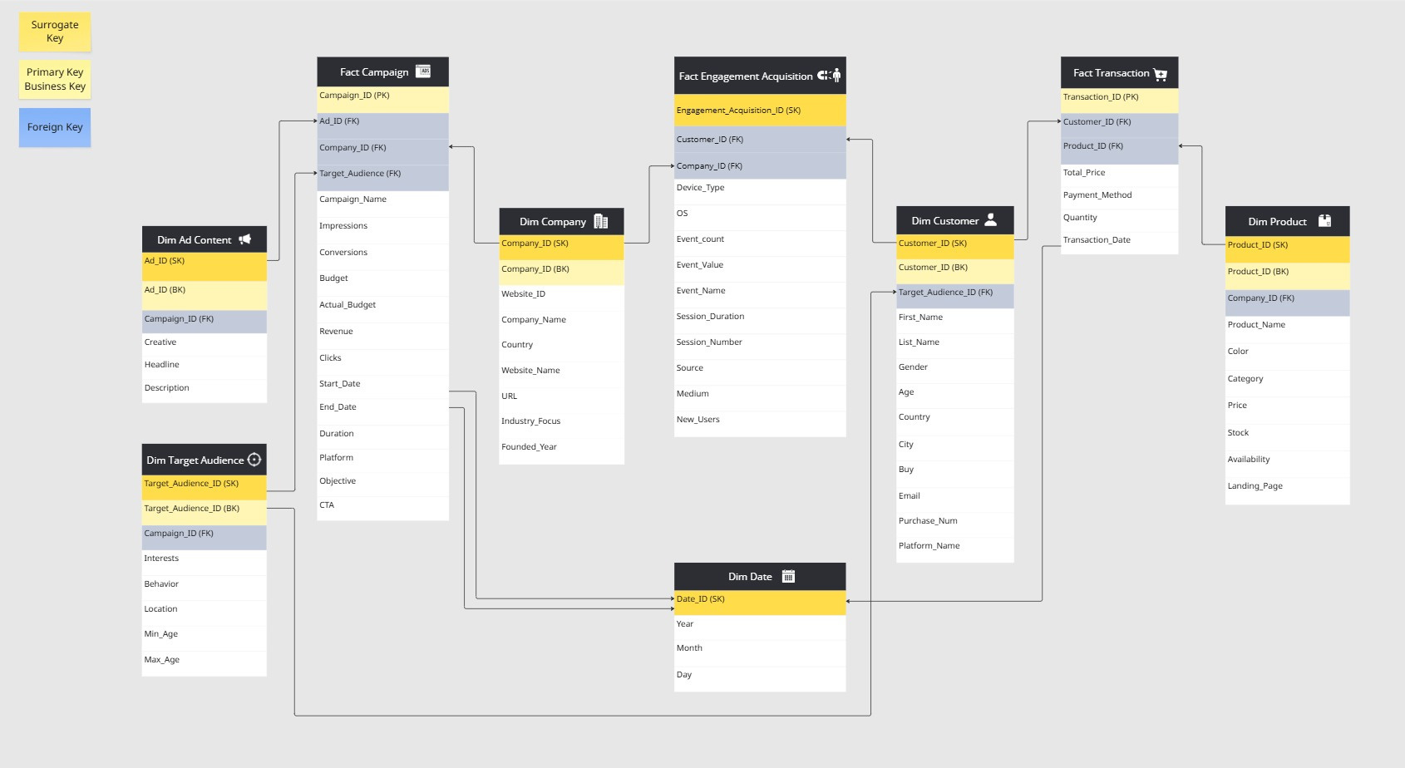
DATA WAREHOUSE GALAXY SCHEMA
19

Slide 20
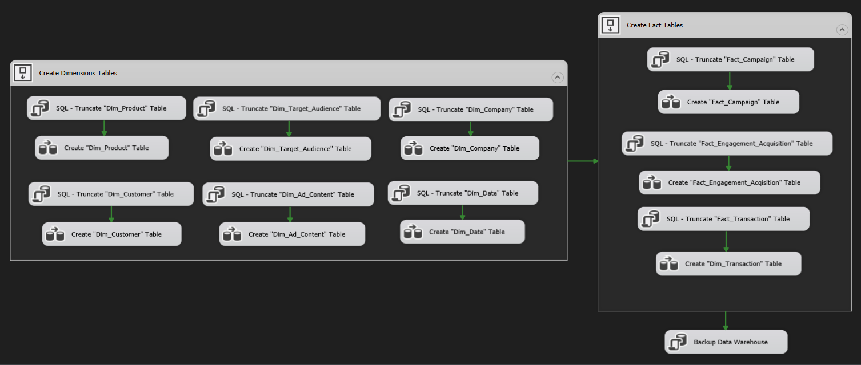
OLAP ETL - CONTROL FLOW
20

Slide 21
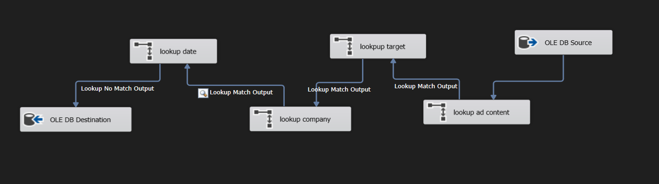
FACT CAMPAIGN DATAFLOW
21

Slide 22
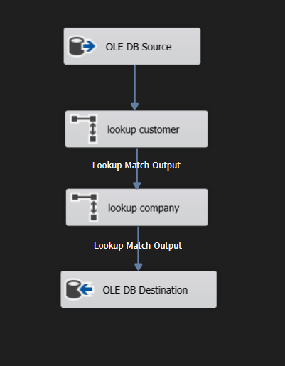
FACT ENGAGEMENT DATAFLOW
22

Slide 23
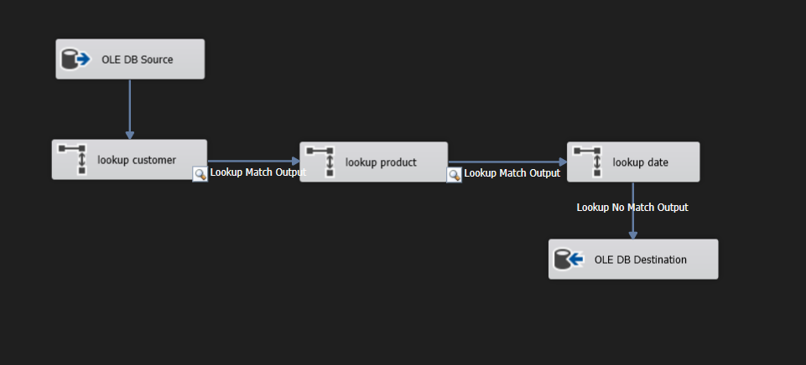
FACT TRANSACTION DATAFLOW
23

Slide 24
ANALYSIS
8.1
SERVICES
24

Slide 25
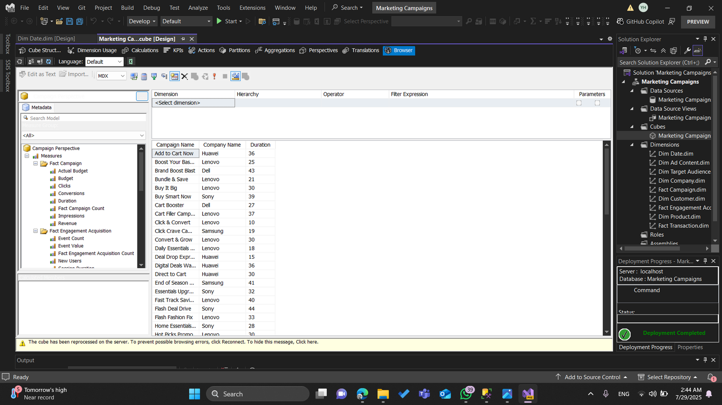
CAMPAIGN CUBE
25

Slide 26
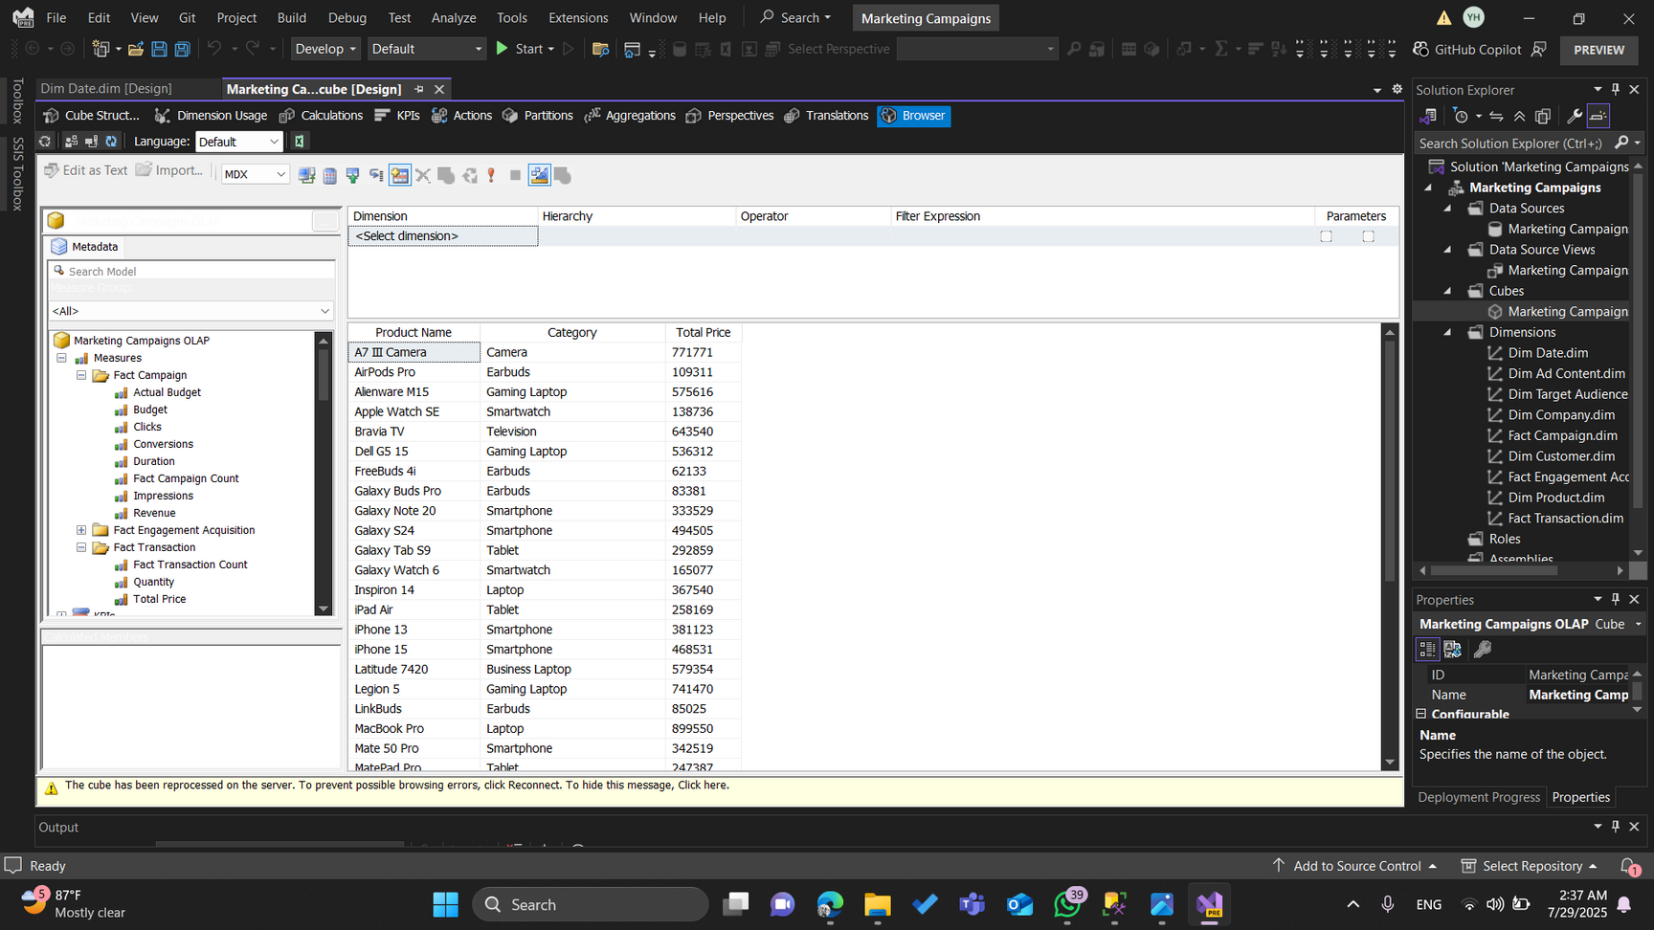
PRODUCT CUBE
26

Slide 27
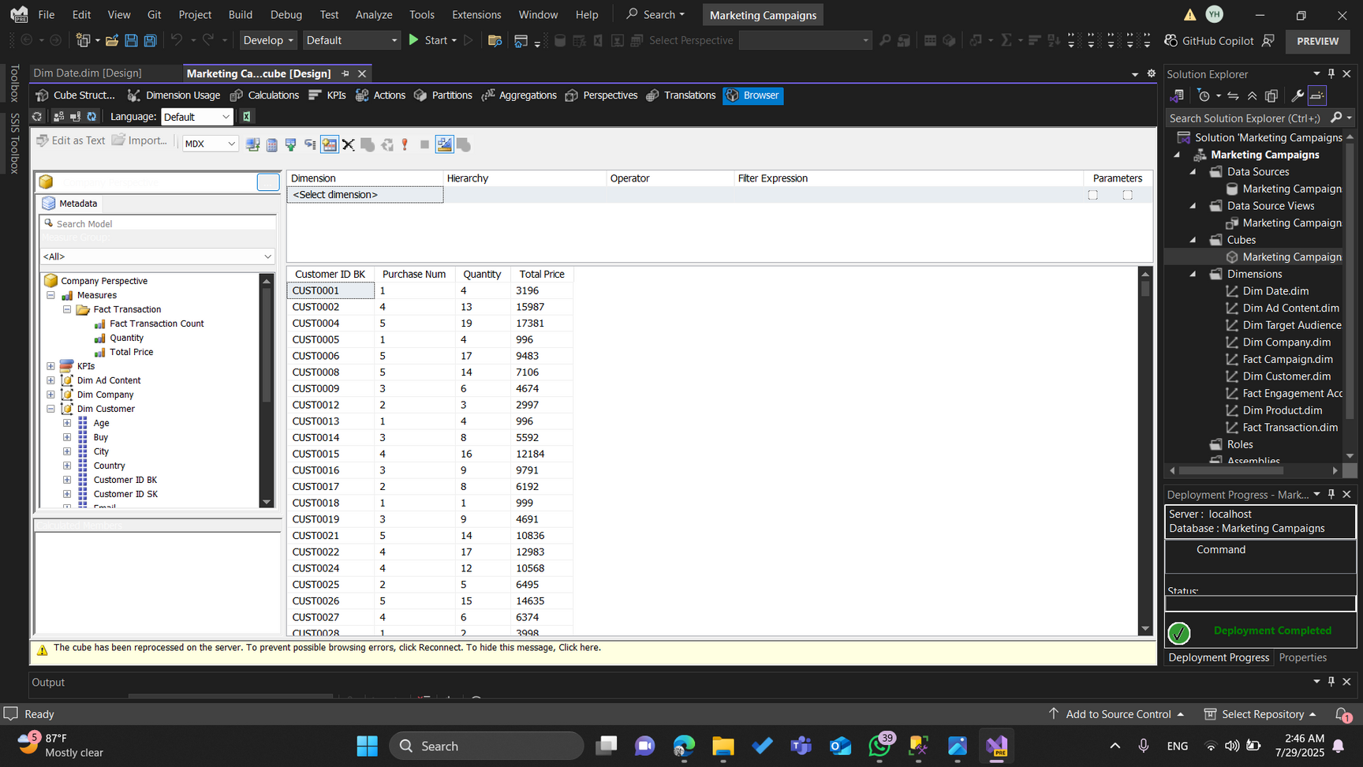
CUSTOMER CUBE
27

Slide 28
REPORTING
8.2
SERVICES
28

Slide 29
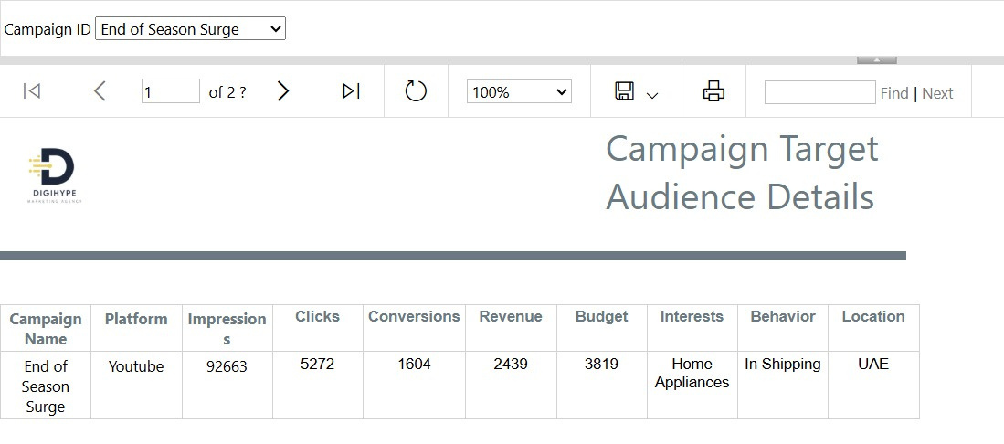
29

Slide 30
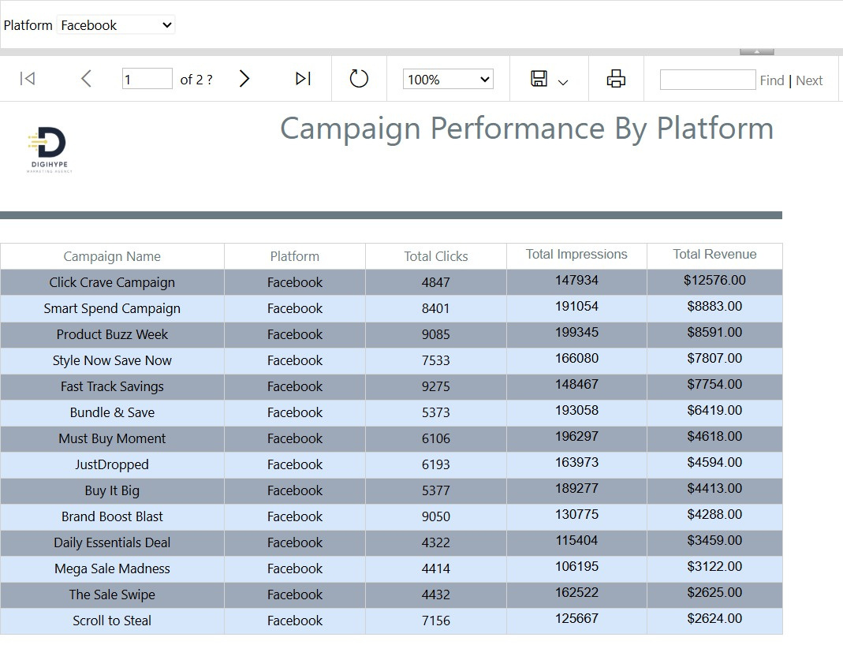
30

Slide 31
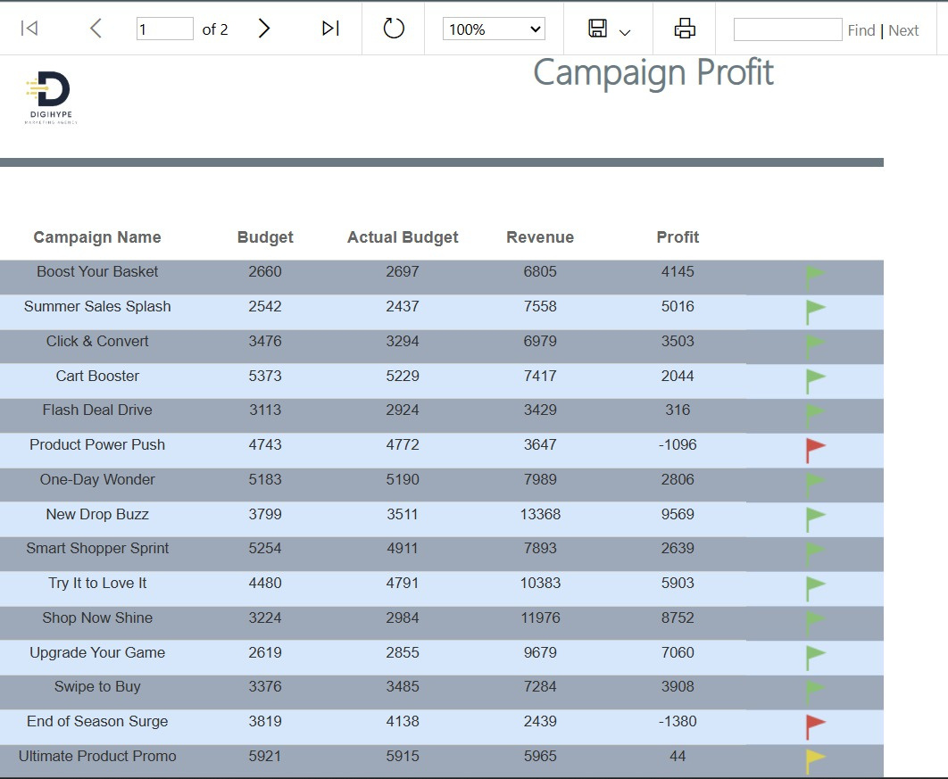
31

Slide 32
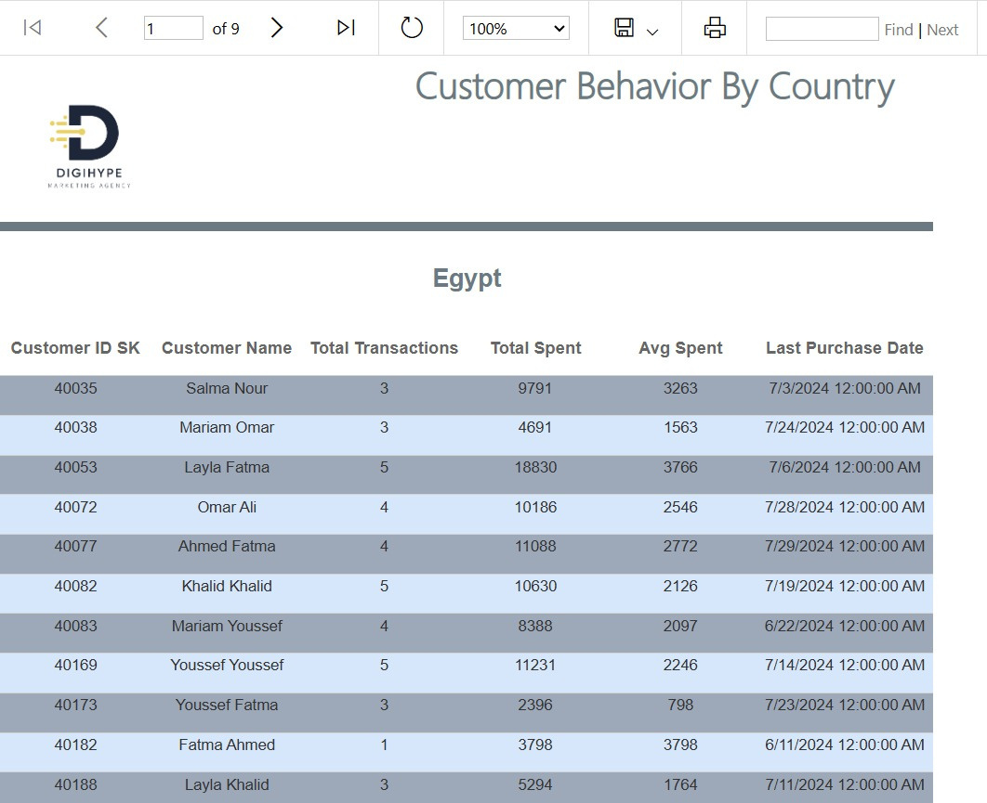
32

Slide 33
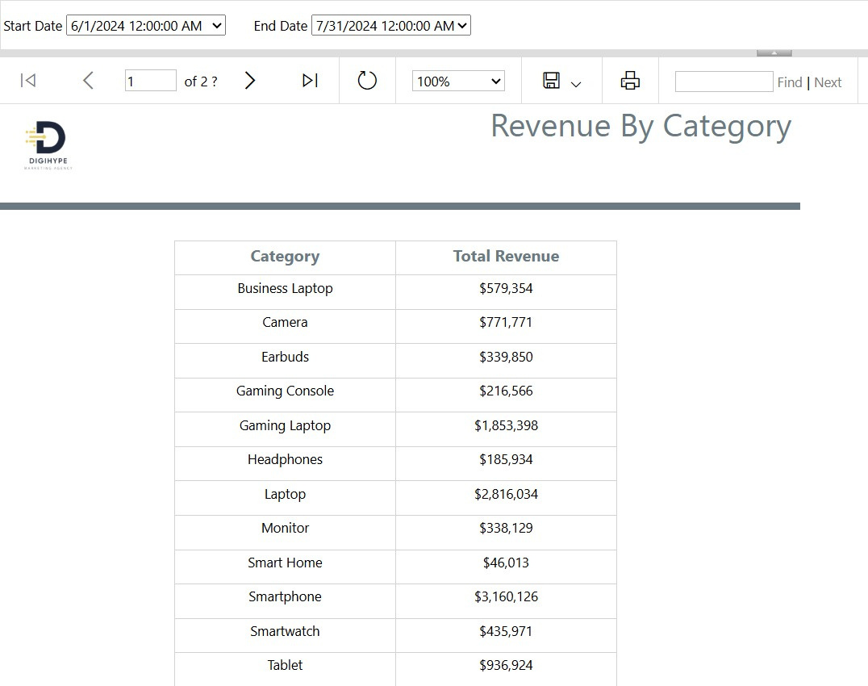
33

Slide 34
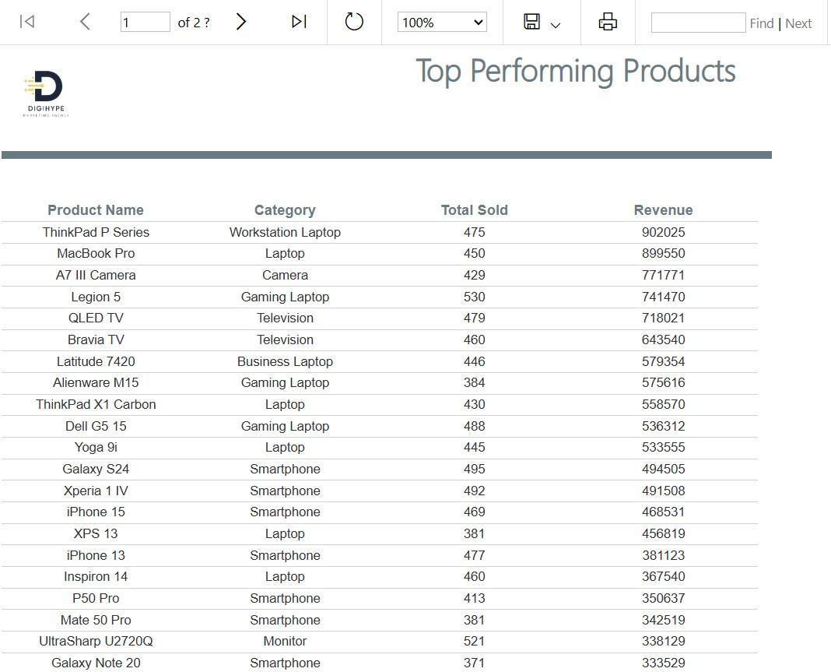
34

Slide 35
DASHBOARD
9.1
POWER BI
35

Slide 36
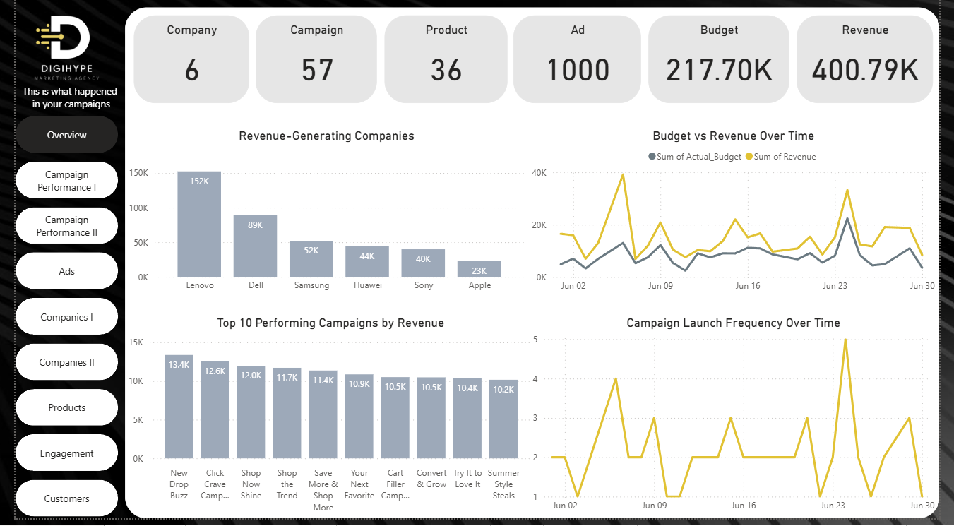
OVERVIEW
36

Slide 37
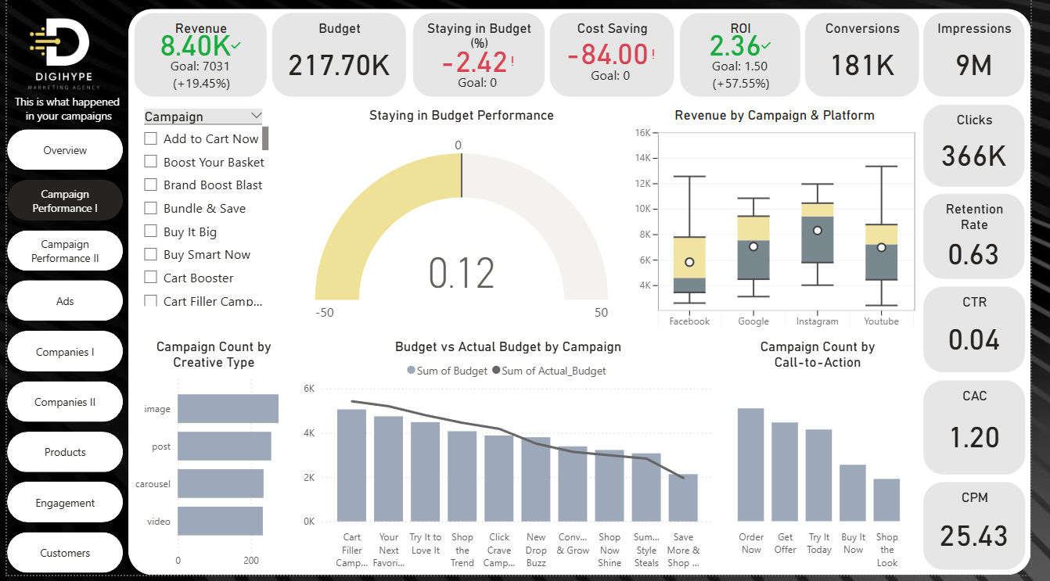
CAMPAGIN PERFORMANCE I
37

Slide 38
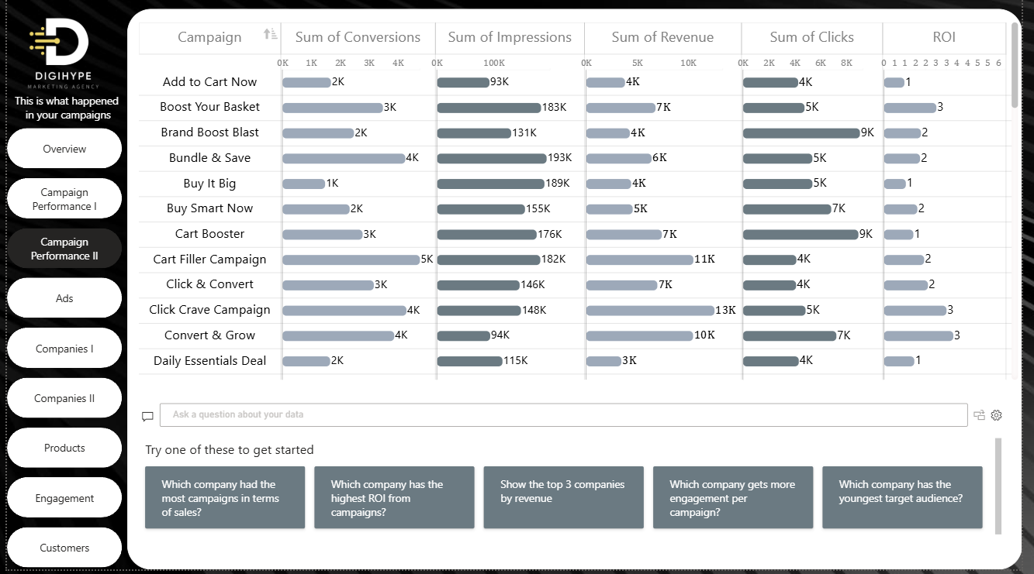
CAMPAGIN PERFORMANCE II
38

Slide 39
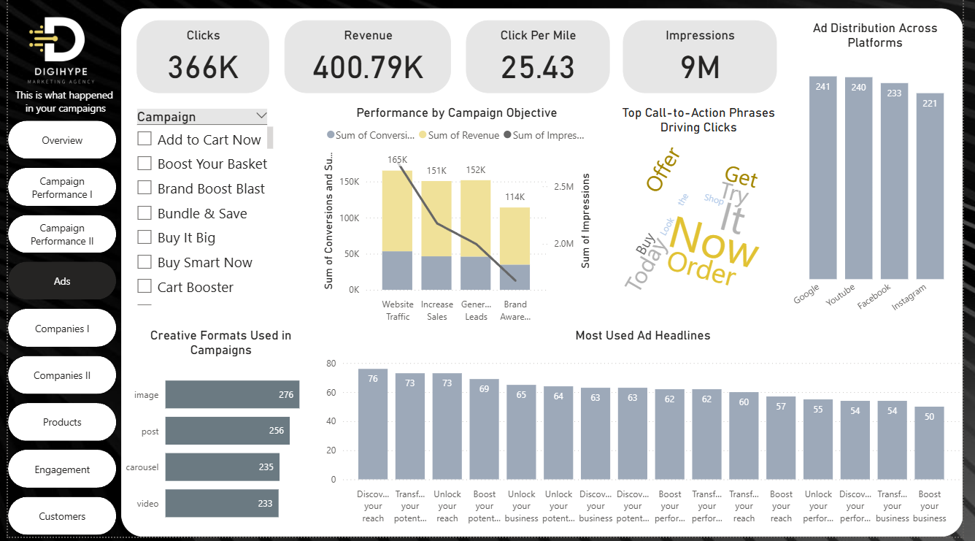
ADS
39

Slide 40
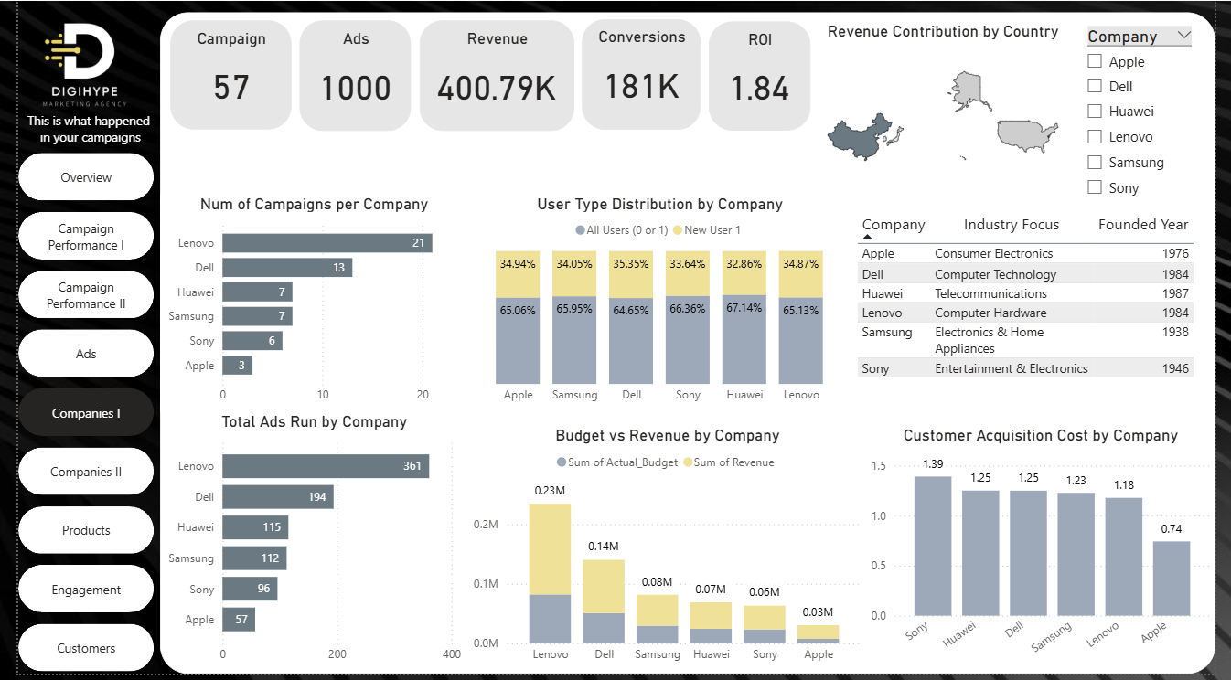
COMPANIES I
40

Slide 41
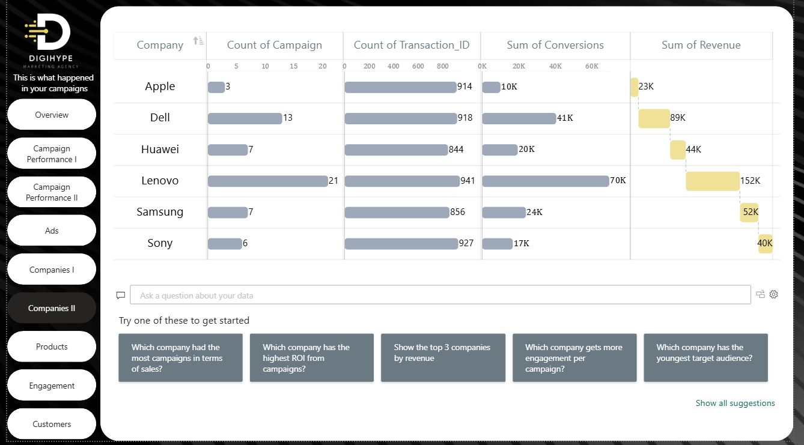
COMPANIES II
41

Slide 42
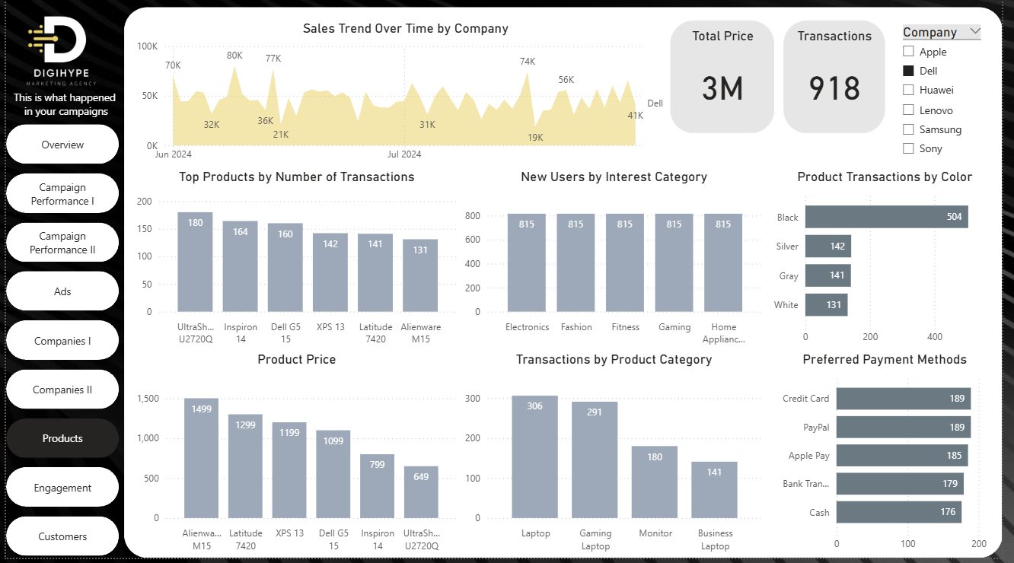
PRODUCTS
42

Slide 43
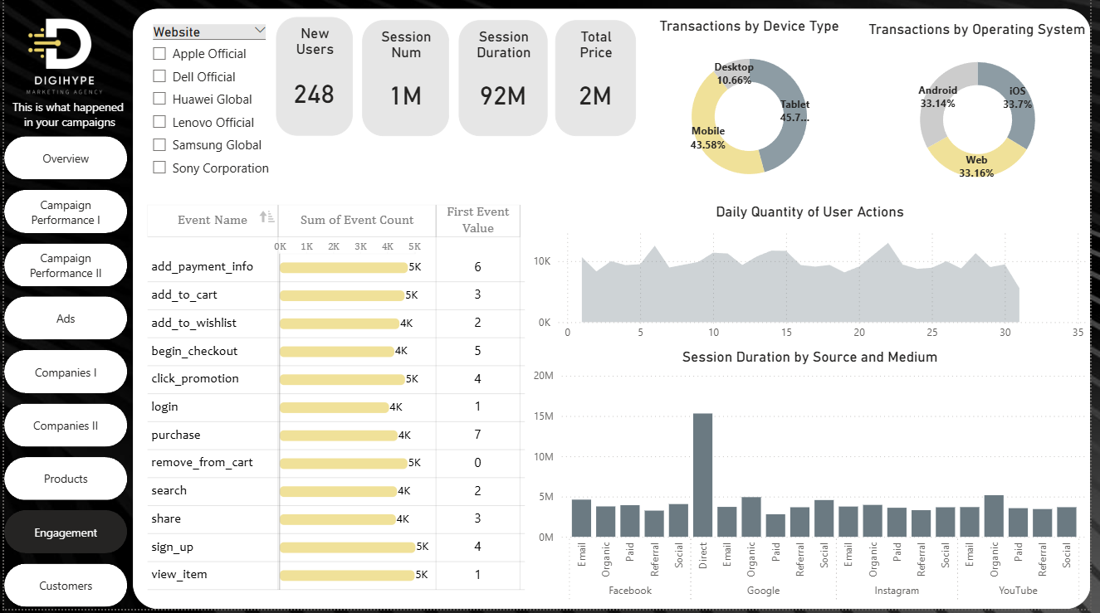
ENGAGEMENT
43

Slide 44
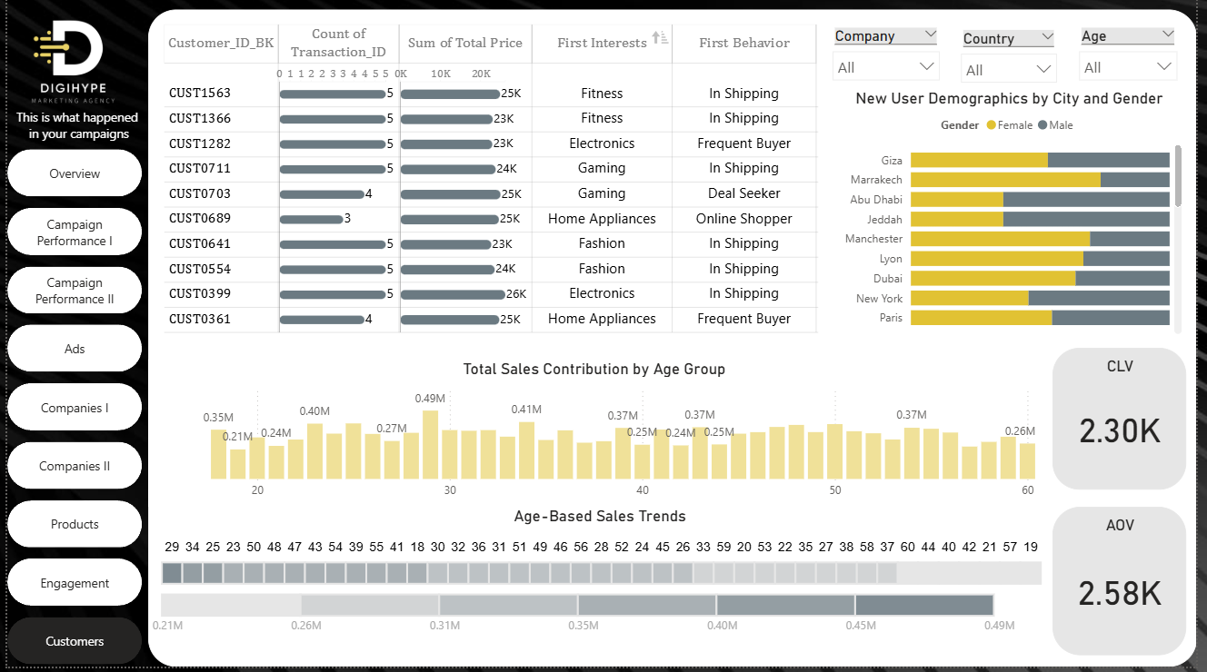
CUSTOMERS
44

Slide 45
DASHBOARD
8.2
TABLEAU
45

Slide 46
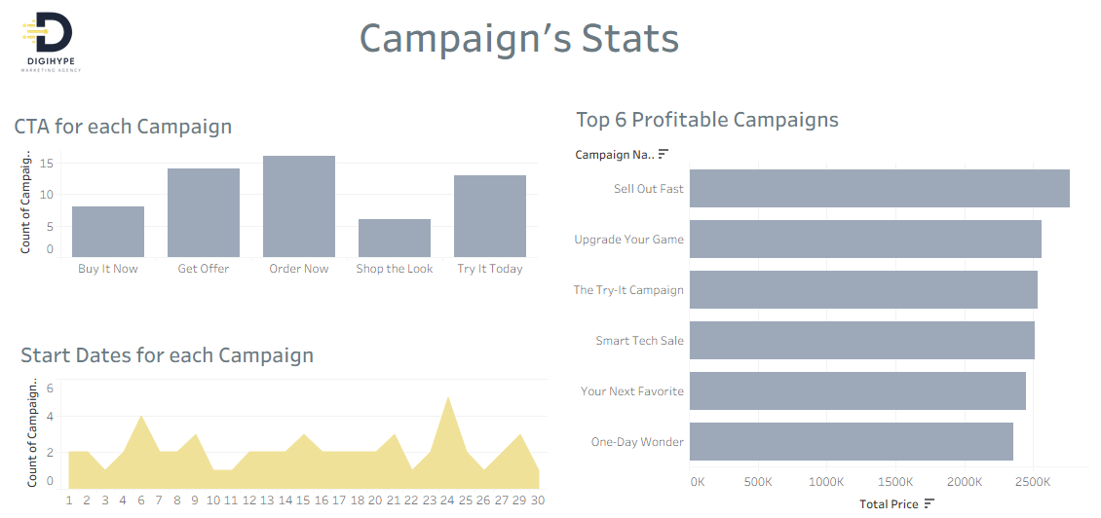
46

Slide 47
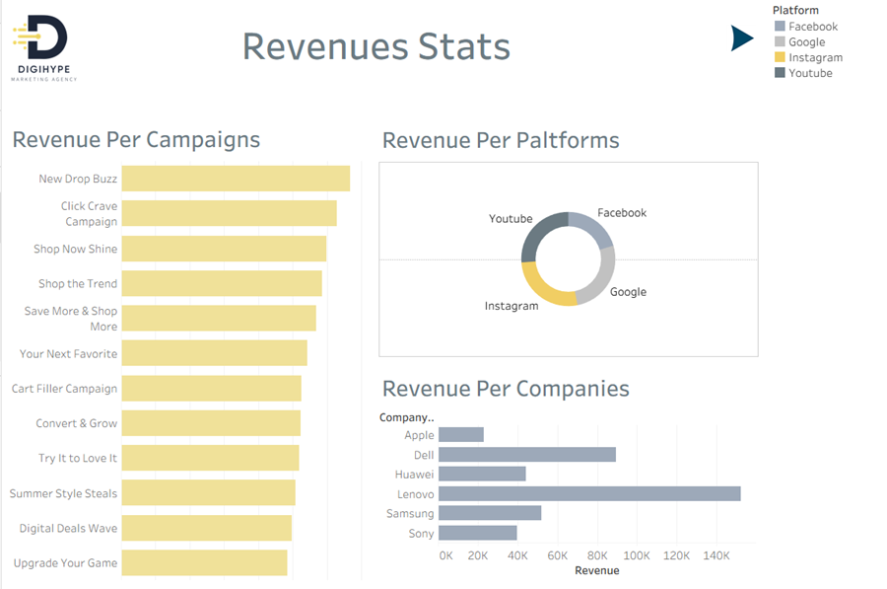
47

Slide 48
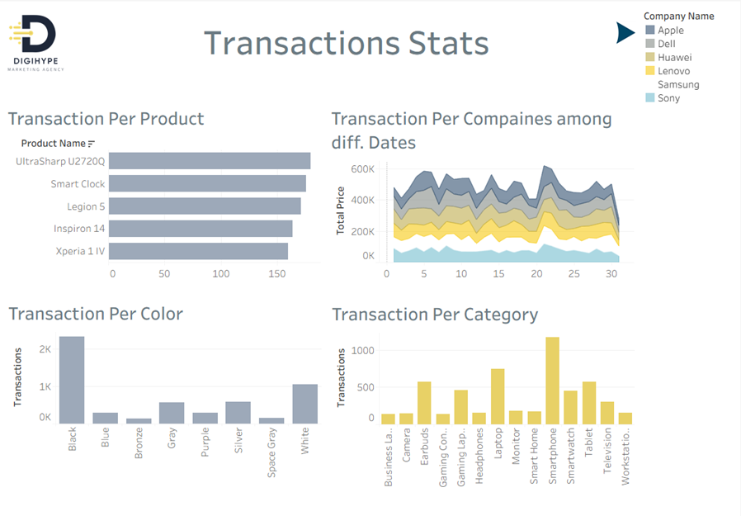
48

Slide 49
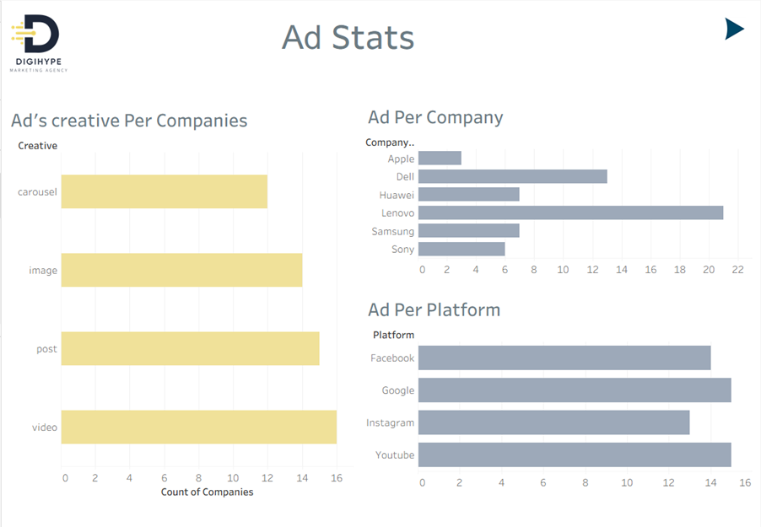
49

Slide 50
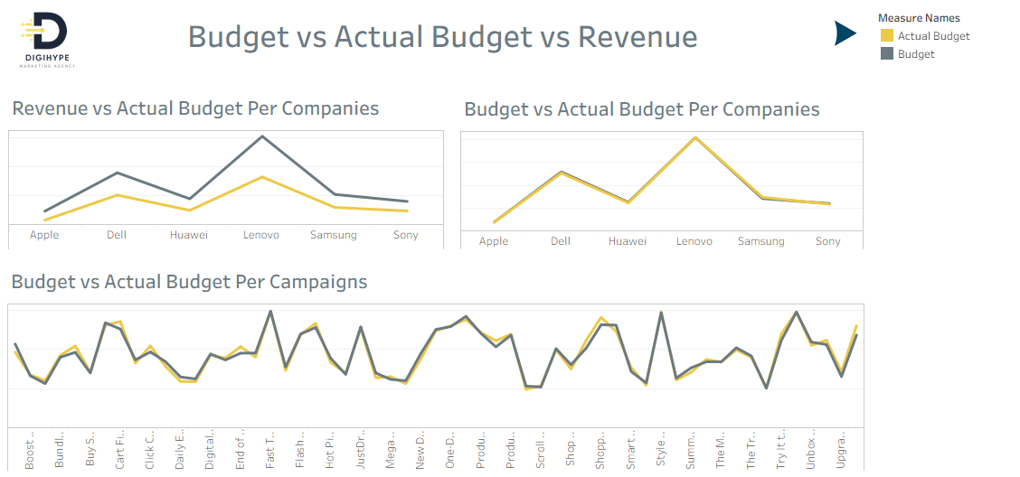
50

Slide 51
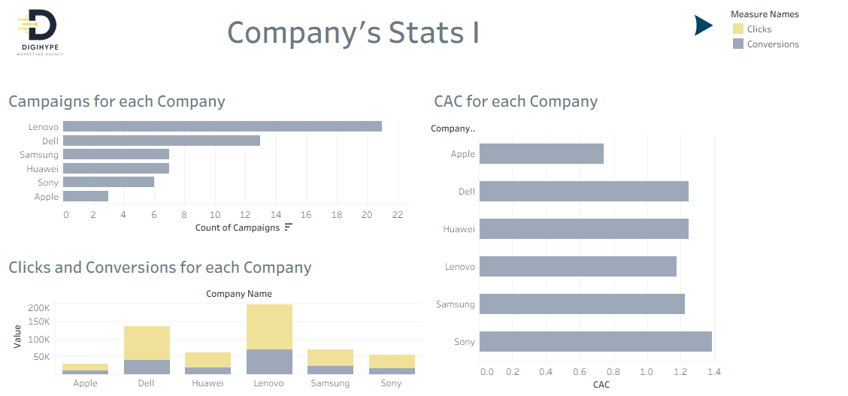
51

Slide 52
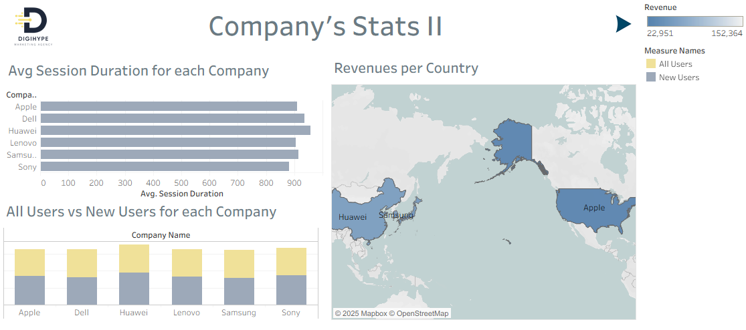
52

Slide 53
10
RECOMMENDATIONS
53

Slide 54

Data shows demand is significantly higher in June and July due to seasonal factors like summer holidays.
Investing more in these months maximizes returns when customers are most ready to purchase.
01
Analysis revealed that some digital channels, such as social media or paid ads, drove stronger engagement and conversions.
Shifting more budget to these high-performing channels ensures better ROI and avoids waste on less effective ones.
02
03
Certain customer segments showed higher purchase rates because their needs aligned closely with the campaigns.
Targeting these profitable groups with tailored messages increases conversions and lowers acquisition costs.
RECOMMENDATIONS
04
54

Slide 55

Q & A
55

Slide 56
THANK
YOU
We hope our work meets your expectations and adds value.
56

